Slide 1
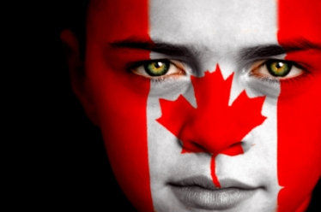
Immigration

Slide 2
Today…..
Terminology
Factors that influence immigration/emigration
Fact or Myth quiz!
The 3 types of immigrants
The history of immigration in Canada
Where do immigrants settle in Canada

Slide 3
Terminology
Emigration – to leave your country of origin to live permanently in another country
Immigration – to move permanently to a country other than one’s native country

Slide 4
Terminology
Push Factor – factors that encourage people to emigrate from their country
Pull Factor – factors that draw immigrants to a country

Slide 5
Factors that influence Emigration
List some examples of push factors:

Slide 6
Factors that influence Immigration
List some examples of pull factors:

Slide 7
Fact or Myth?
Everyone must vote once.
Without immigrants Canada's population would decline rapidly as our birth rate is low at 1.58 children per family.
2) Immigrants alter the "Canadian culture” into the culture of their country of origin.

Slide 8
Fact or Myth?
3) Some immigrants are not allowed to work in their professions until they become licensed in Canada. Many do not ever get to practice their professions as the paperwork and processes are quite expensive.

Slide 9
Fact or Myth?
4) Immigrants create jobs by starting new businesses and therefore bring financial resources to invest into the Canadian economy
5) Immigrants are usually less educated and skilled than most Canadians. Coming from other countries, immigrants are less likely to have a university education

Slide 10
Fact or Myth?
6) More Canadian money is spent on social services, such as welfare, for immigrants rather than Canadian-born citizens.

Slide 11
We’re all the same…
All Canadians fit into one of three categories….
First Nations
descendants of immigrants
born in another country

Slide 12
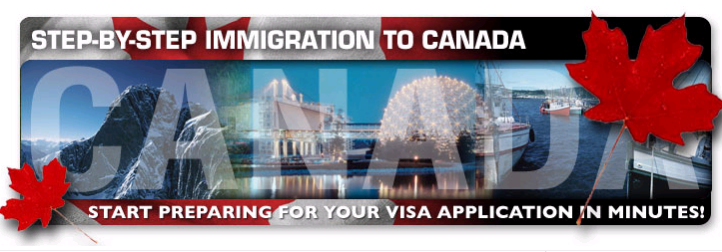
3 Types of Immigrants
Economic Immigrants
Family Class Immigrants
Refugees

Slide 13
Economic Immigrants
These are immigrants that come to Canada alone
They are accepted based on a point system, and there are two sub-types.
67 points as a skilled worker will get you in.
35 points as a business immigrant as well as enough $$$ will get you in.
http://www.workpermit.com/canada/points_calculator.htm

Slide 14
Family Class Immigrants
To allow people to reunite with their family, partners, and spouses.
Every family immigrant must be sponsored by a relative in Canada.
Sponsors are financially responsible for 10 years.

Slide 15
Refugees
Someone who fears cruel or inhumane treatment (or even death) in their home country
Persecution may occur for reasons of race, religion, nationality, political opinion, etc
People can apply to become refugees while visiting in Canada or from their home country (UNHCR)
24, 000 – 33, 000 per year come to Canada

Slide 16
Canada`s Immigration History
This has changed immensely in the last 100 years
late 1800s and early 1900s - Europe
Increase after times of war and during good economic times, decrease during poor economic times
Since then we have seen large numbers of people from African countries and parts of Asia
Most immigrants today come from Eastern Asia (China, India, Hong Kong)
Refugees change every year, depending on politics

Slide 17
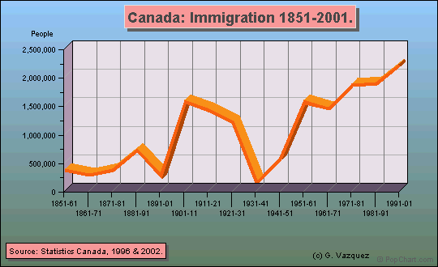
History of Immigration

Slide 18
Where do Immigrants Settle in Canada?
Large cities like Toronto, Vancouver, Montreal, and even Kitchener-Waterloo
Why?

